Slide 1


15th International Conference on COMmunication Systems & NETworkS, 2023
A Cost Effective Reliability Aware Scheduler for Task Graphs in Multi-Cloud System
Atharva Tekawade
Undergraduate Research Fellow, Dept. of CSE
Indian Institute of Technology Jammu
Jammu and Kashmir, India
Suman Banerjee
Asst. Professor, Dept. of CSE
Indian Institute of Technology Jammu
Jammu and Kashmir, India
November 30, 2022

Slide 2
Outline
Introduction
Literature Survey
Problem Definition
Our Contributions
Proposed Solution Approach
Results
Conclusion & Future work
References

Slide 3
Introduction
Cloud computing has emerged as an alternative computing framework and become popular due to many features including “pay as you use” kind of billing strategy, virtualization, rapid elasticity, on-demand use, etc.
Many real world applications and scientific workflows like Epigenomics, Cybershake, Ligo, Montage are being deployed on cloud computing platforms.
Due to the large resource requirement and options provided by different cloud providers, these workflows are being deployed across multiple clouds.
Scheduling of such workflows keeping in favor of lower cost, makespan and higher reliability remains an active area of research.
With multiple cloud vendors in the picture, we need to keep in mind the different pricing mechanisms that are employed by each vendor.
In this work, we model the different pricing mechanisms and the discounting schemes used. Then, we tackle the problem of scheduling such workflows using a list-scheduling approach.
An extensive set of experiments done with real-world workflows shows that our method outperform the existing state-of-art methods.

Slide 4
Our Contributions
Proposed a system model to study workflow scheduling in a multi-cloud system considering communication costs and different pricing mechanisms.
Did the reliability analysis for task execution considering that the failure of the tasks is modeled using Poisson Distribution.
Proposed a list-based scheduling approach to achieve low cost, makespan and high reliability.
Conduct extensive set of experiments with real world workflows.
Compare performance with existing solution approaches.

Slide 5
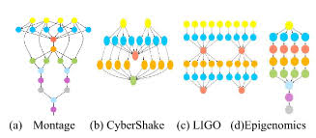
Scientific workflow
Many real-world workflows are modeled as a Directed acyclic graph (DAG) G(V, E).
V: Denotes the set of individual tasks of the workflow. w(v_{i}) denotes the computation requirement of v_{i}. V = {v₁, v₂,..., v_{n}}
E: Denotes the set of edges (v_{i}, v_{j}) indicating a data or control-flow dependency between the tasks i.e. v_{j} cannot start unless v_{i} finishes and transfers the output to it. The weight of edge w(v_{i}, v_{j}) denoted the size of output needed to be transferred.

Slide 6
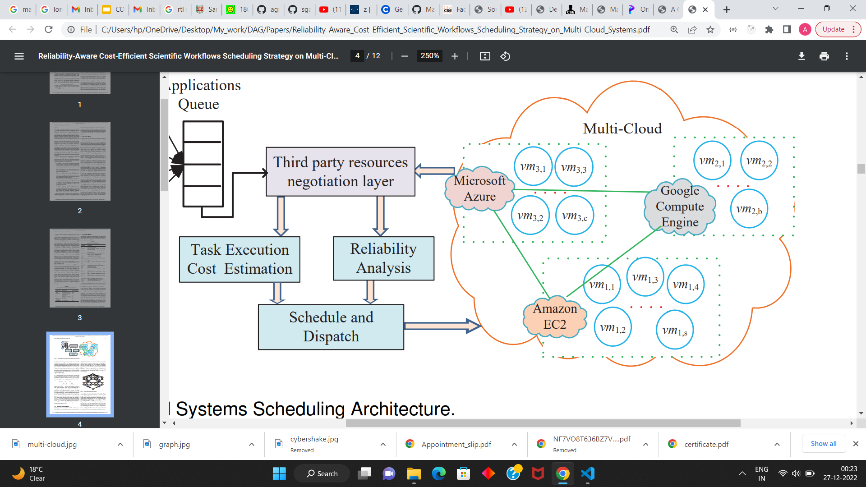
Multi-cloud system
Each cloud provider provides its resources in the form of Virtual Machines (VMs). The VMs from all the providers are combined into a single set. VM(k, p) denotes the VM of the p^{th} type offered by the k^{th} cloud. w(VM(k, p)) denotes the amount of computation that can be performed by the VM in unit time.
VMs belonging to the same provider are connected by high-speed internal network, while those across clouds are connected by low-speed external network. Hence the time required to transfer data between v_{i} and v_{j} is: T_{comm}[v_{i}, v_{j}] = w(v_{i}, v_{j})/bandwidth.

Slide 7
Notations and Timing Metrics
pred(v_{i}) (Predecessor set of v_{i}): Denotes the set of predecessor tasks of v_{i}.
succ(v_{i}) (Successor set of v_{i}): Denotes the set of successor tasks of v_{i}.
ST_{vi} (Start time of task v_{i}) = max _{vj in pred(vi)} FT_{vj} + T_{comm}[v_{i}, v_{j}]
TE_{vi} (Execution time of task v_{i}) = w(v_{i})/w(VM(k, p))
FT_{vi} (Finish time of task v_{i}) = ST_{vi} + TE_{vi}
PT_{vi} (Processing time of task v_{i}) = max _{vj in pred(vi)} FT_{vi} - FT_{vj}
makespan = max _{vi in V} FT_{vi}

Slide 8
Pricing Mechanisms
AWS: Follows a coarse grained pricing where customer is charged per hour of usage (T = 1 hr) [4].
MA & GCP: Follow a fine grained pricing where customer is charged per minute of usage
(T = 1 min) [4], [22].
Hence the cost of executing task v_{i} C_{vi,exec} = ⌈PT_{vi}/T⌉ * C_{k,p} , where C_{k,p} denotes the price for a single billing period for using VM(k, p).

Slide 9
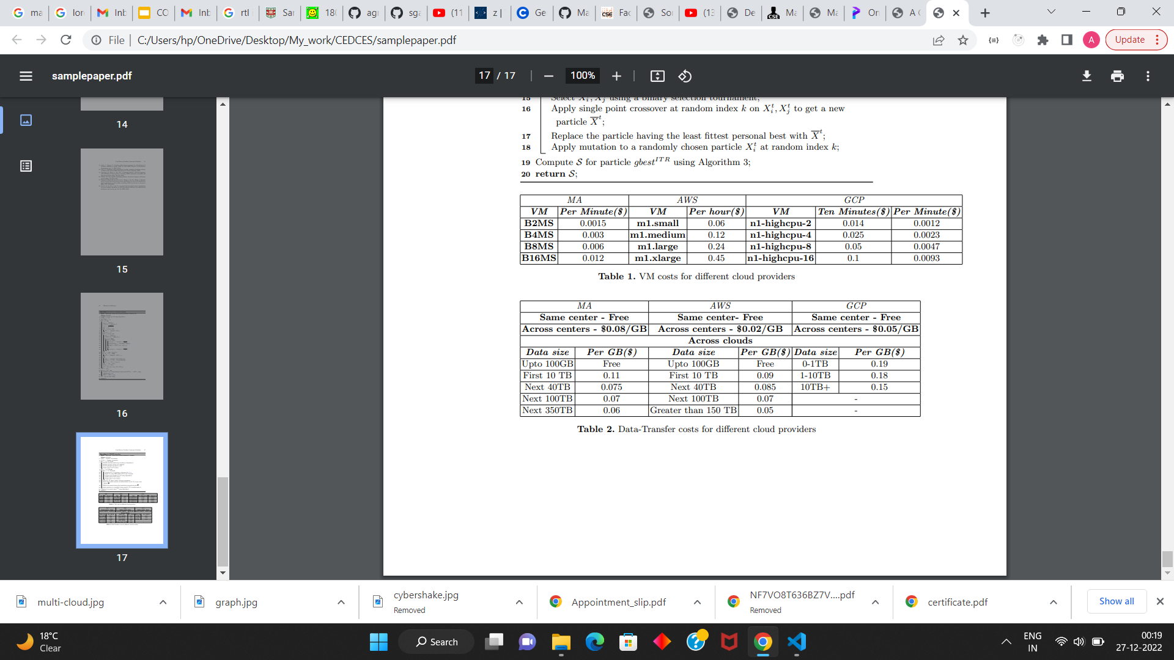
Pricing Mechanisms
Apart from this each provider charges some amount for sending data out. This price is charged per unit of data and depends on the location as shown in the below table. Hence the cost of transferring data for v_{i} C_{vi,comm} = 𝝨_{vj in pred(vi)} w(v_{j}, v_{i}) * C_{k, k’} where C_{k, k’} denotes the price per unit data across the k^{th} and k’^{th} clouds which can be got from the below table.
The total cost of executing task v_{i} is given by C_{vi} = C_{vi,exec} + C_{vi,comm} and the cost of executing the workflow cost = 𝝨_{vi in V} C_{vi}

Slide 10
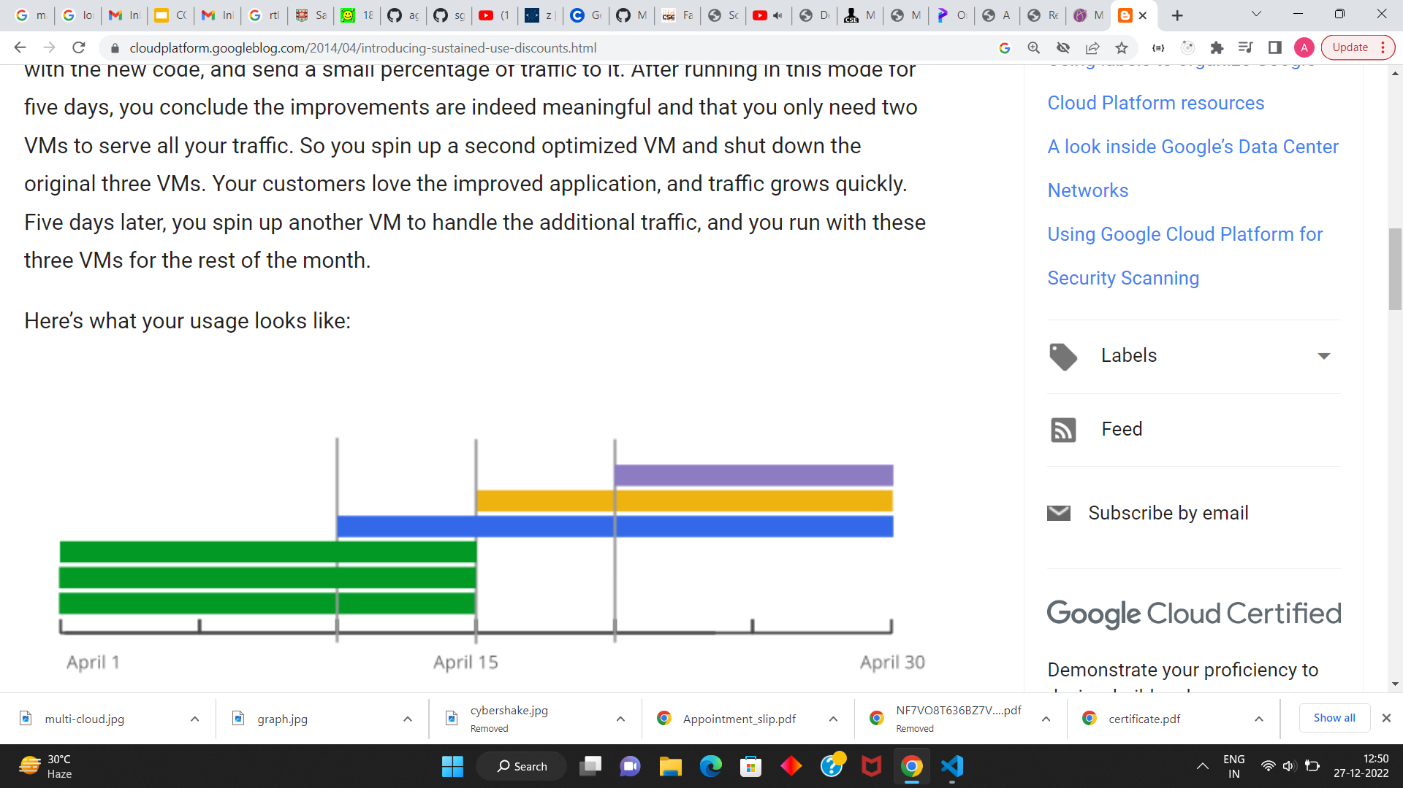
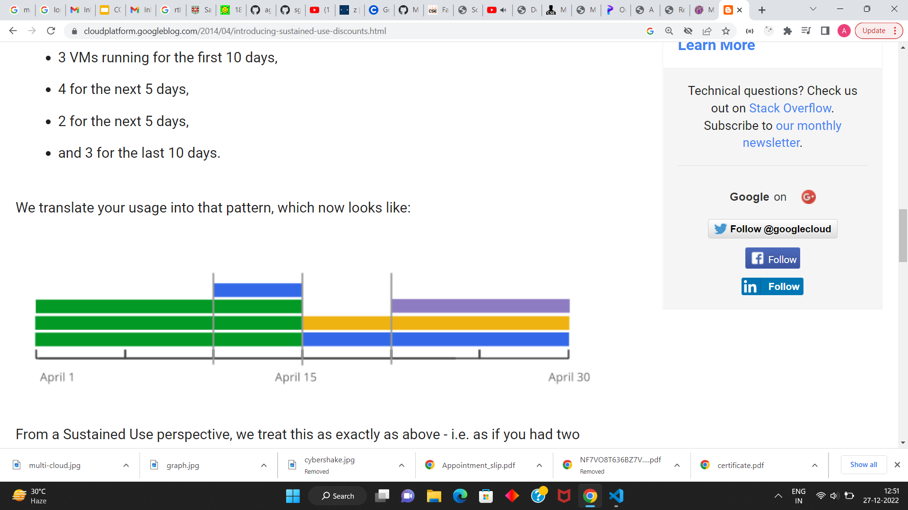
Sustained Use Discounts
When resources are being used for a sustained amount of time, discounts will be offered depending on the period for which they were running. The amount of discount increases with run time.
The VM usage patterns are combined into multiple non-overlapping instances each with the longest possible duration.
This approach lets us give you the greatest possible discount for a given usage pattern.
Source: https://cloudplatform.googleblog.com/2014/04/introducing-sustained-use-discounts.html

Slide 11
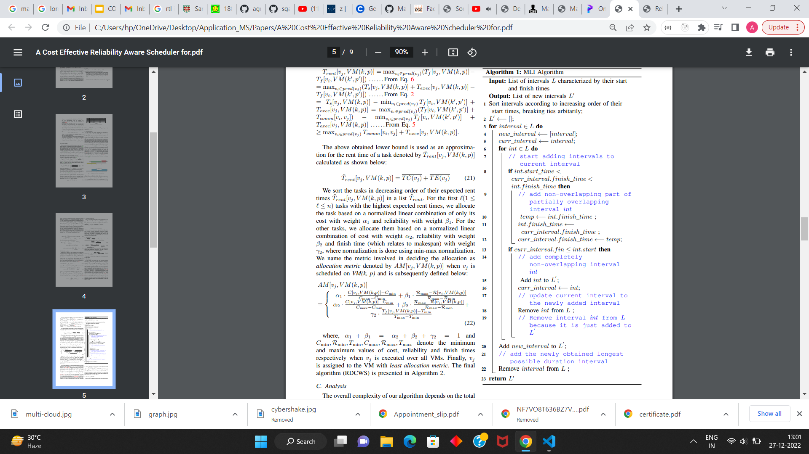
Obtaining Longest Intervals - MLI Algorithm
Given a set of interval usage pattern, the MLI algorithm comes up with the set of new non-overlapping intervals with longest duration.
The process begins by sorting the intervals in increasing order of their start times.
Then intervals are picked in order, and checked if they can be combined with subsequent ones resulting in larger length intervals.
If there is a overlap between intervals, we combine one interval with the non-overlapping part of the other and keep the remaining overlapping part as a single interval.

Slide 12
Reliability analysis
The reliability is an essential to keep multi-cloud systems delivering affordable and dependable services.
This systems reliability can be defined as the probability of failure-free workflow application execution for a specified period of time on multi-cloud environment.
In this work, the Poisson distribution to estimated task execution reliability on VMs and communication links.
The reliability of executing v_{i} on VM(k, p) is given by R_{vi, exec} = e^{-λk,p * PTvi} where λ_{k,p} is the parameter of Poisson distribution of VM(k, p).
The reliability of transferring data w.r.t vi is given by R_{vi,comm} = 𝚷_{vj in pred(vi)} e^{-λk,k’*Tcomm[vj, vi]} where λ_{k, k’} denotes the parameter of Poisson distribution for transferring data between the k^{th} and k’^{th} clouds.
The reliability of executing task v_{i} R_{vi} = R_{vi,exec} * R_{vi,comm} and the reliability of executing the workflow is reliability = 𝚷_{vi in V} R_{vi}

Slide 13
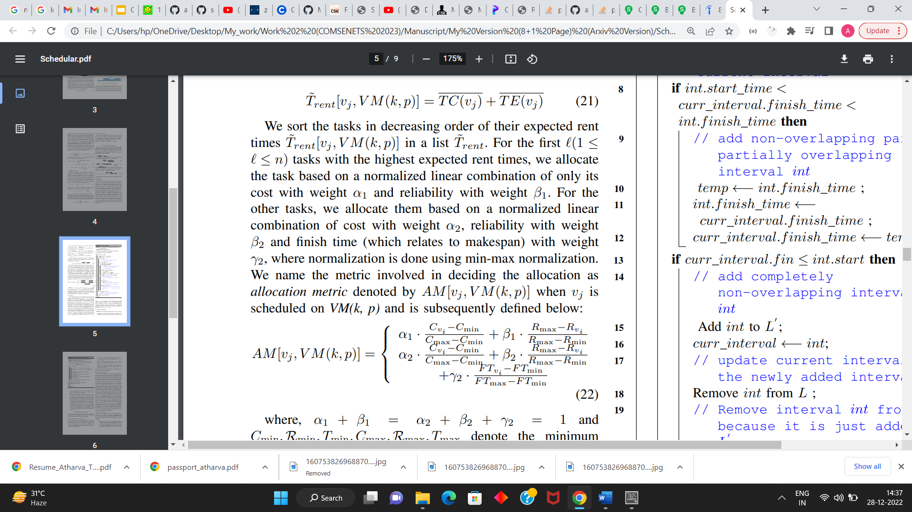
Proposed Solution Approach
We follow a list-scheduling approach which is known to be an effective and efficient method to solve DAG scheduling problems.
It occurs two phases:
Task Ordering: The tasks are ordered based on rank. The rank of a task is calculated recursively by travelling the DAG in a bottom-up fashion: Rank(v_{i}) = max_{vj in succ(vi)} Rank(v_{j}) + TE(v_{i}) + TC(v_{i}) where TE(v_{i}) is the mean time of executing v_{i} over all VMs and TC(v_{i}) = max_{vj in pred(vi)} w(v_{j}, v_{i})/bandwidth. Basically the rank gives an estimate of the time to execute tasks frok v_{i} to v_{n}. The tasks are ordered are in decreasing order of rank values. This ensures that a task always occurs before any of its successors.
VM allocation: First we calculate the processing time of a task = TE(v_{i}) + TC(v_{i}), and order the tasks in decreasing order of processing time. A task is allocated to the VM satisfying the below equation, where the first ℓ (0 ≤ ℓ ≤ n) tasks are allocated based on the first equation and the remaining on the second.

Slide 14
Proposed Solution Approach - Flexibility
Depending on which metric is more important, the weights can be adjusted accordingly. In this study, we give more importance to cost over makespan and reliability. The weights are thus chosen as: α1 = 0.8, β1 = 0.2 and α2 = 0.6, β2 = 0.2, γ2 = 0.2
By varying the parameter ℓ, RDCWS generates a family of solutions. Depending on our requirements, we can choose the appropriate solution. For example, by choosing a small value of ℓ, we allocate more tasks based on finish time, hence improving makespan. Out of the family of solutions generated by RDCWS, we choose the one with minimum cost for comparison in our experiments.

Slide 15
Baseline Methods
Fault-tolerant Cost-Efficient workflow Scheduling Algorithm (FCWS) [4]: This is a list-based scheduling that focuses on scheduling workflows on multi-cloud systems taking into account the makespan, cost and reliability. VMs are assigned based on a linear combination of cost and reliability. Fault-tolerance is based on hazard rate of the distribution used for reliability analysis. In our case of Poisson distribution, the condition for fault-tolerance used in FCWS algorithm does not apply, so we do not consider it. Also FCWS does not consider communication cost while assigning VMs, so we include it in the cost while assigning VMs.
Fuzzy resource utilization (FR-MOS) [3]: This is a particle-swarm optimization method for scheduling scientific workflows. The algorithm minimizes cost and makespan while considering reliability constraint calculated using fuzzy logic on resource utilization.

Slide 16
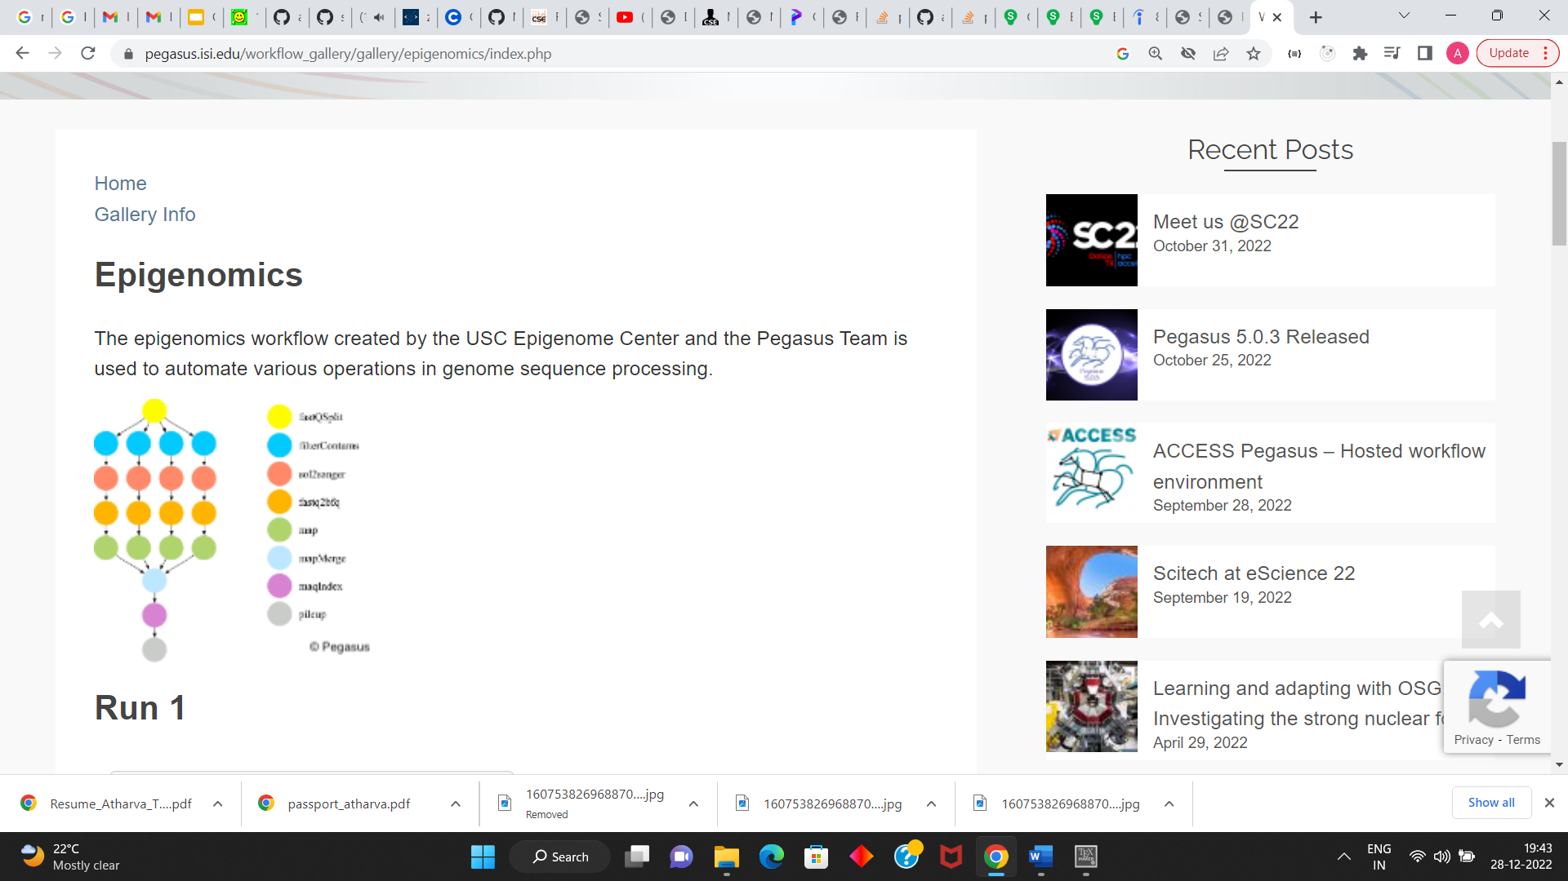
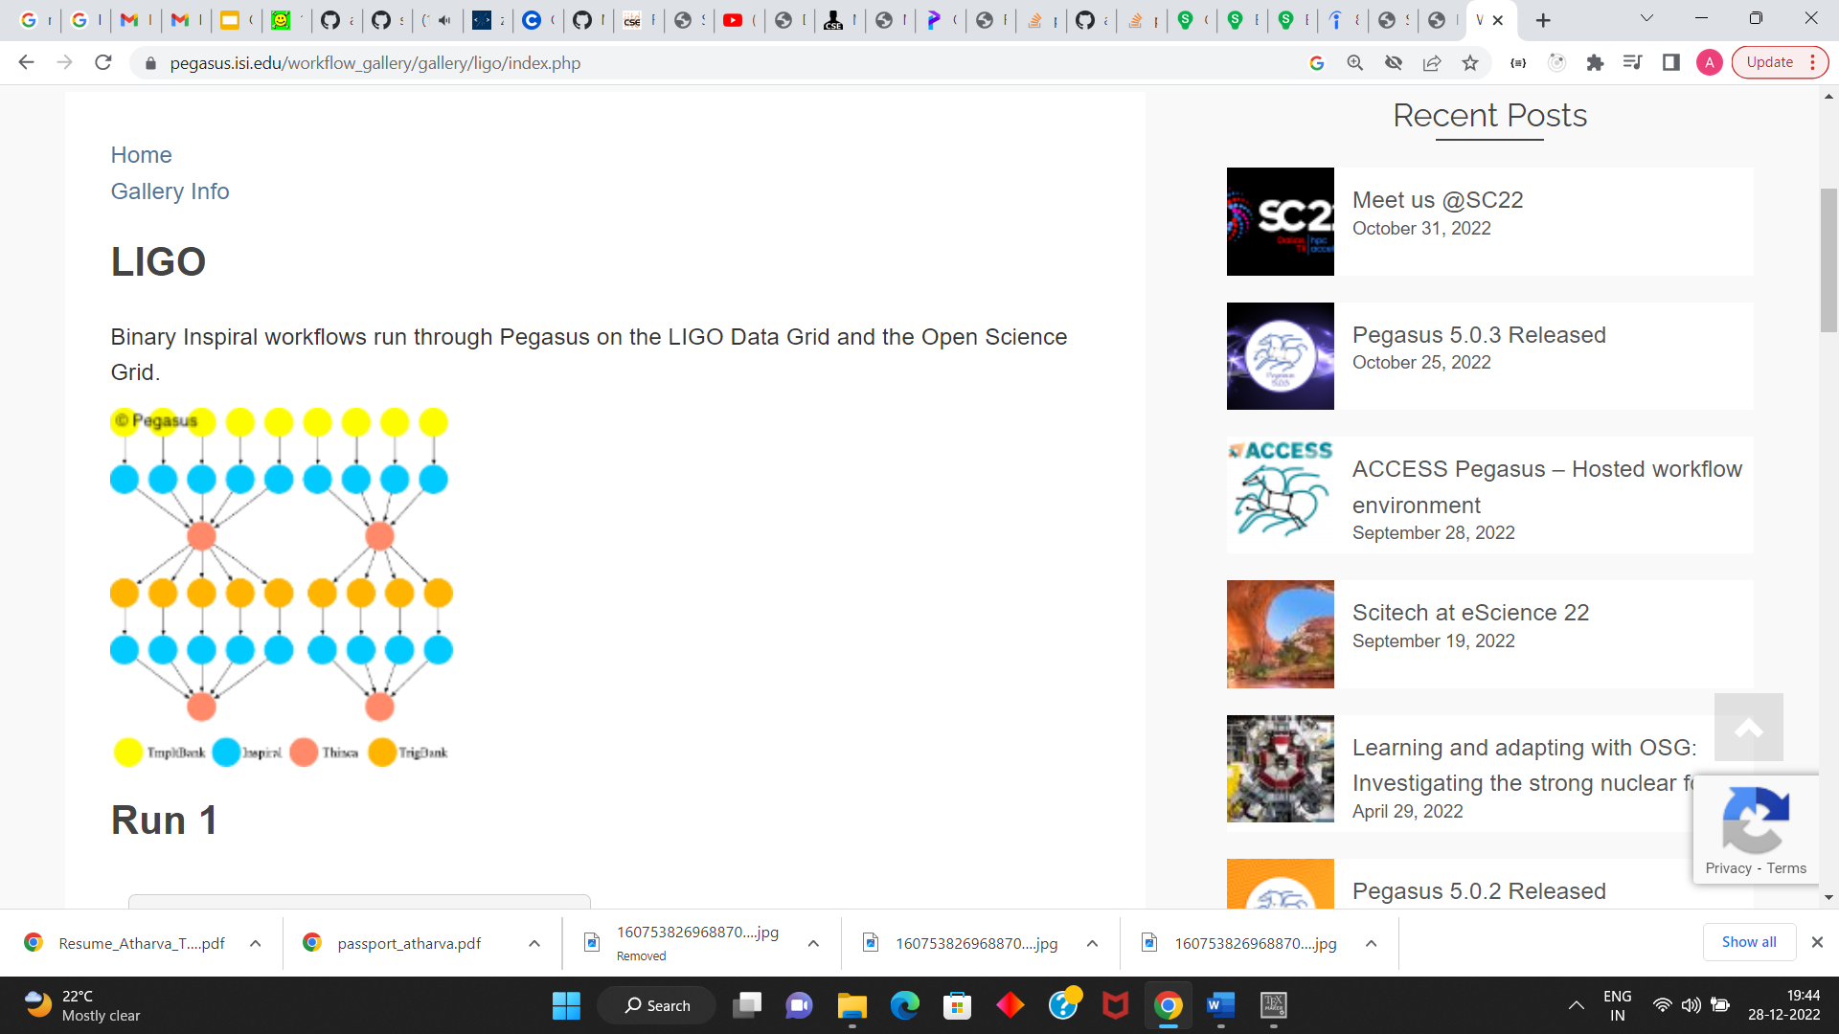
Experimental Description
We two common workflows which are widely used in literature [3], [4], [6]. Each workflow is tested for two node sizes. The smaller size of each workflow is called Small (S), and the larger one is called Large (L).
Epigenomics: The epigenomics workflow created by the USC Epigenome Center and the Pegasus Team is used to automate various operations in genome sequence processing. We consider n = 24, 100.
LIGO: LIGO was originally proposed as a means of detecting these gravitational waves. We consider n = 31, 100.
The structure of each workflow can be obtained in XML format from the website [31] as described in [32].
Remaining parameters of the multi-cloud system are chosen according to [4].
Epigenomics LIGO

Slide 17
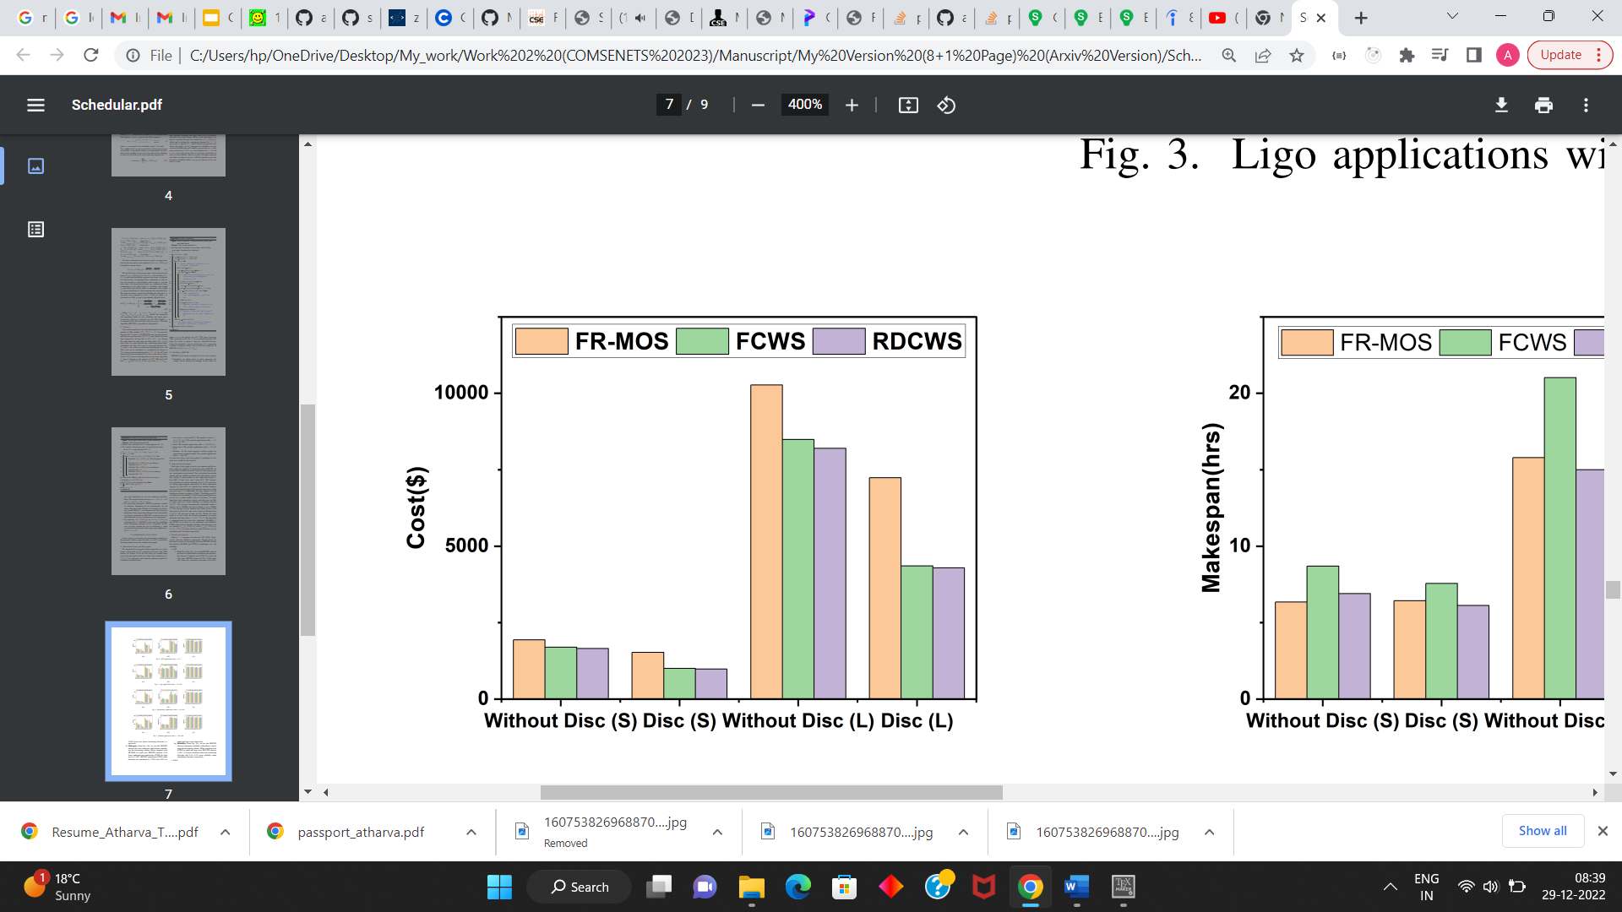
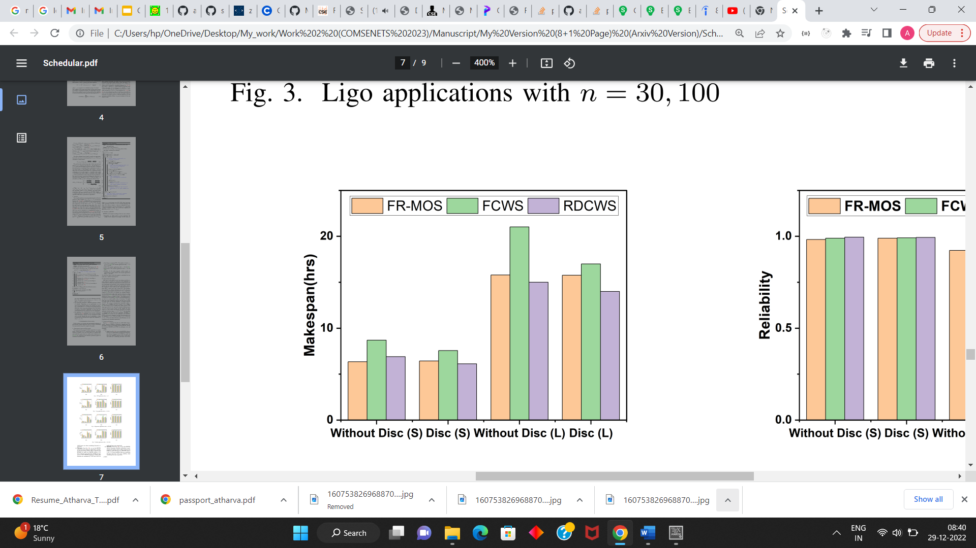
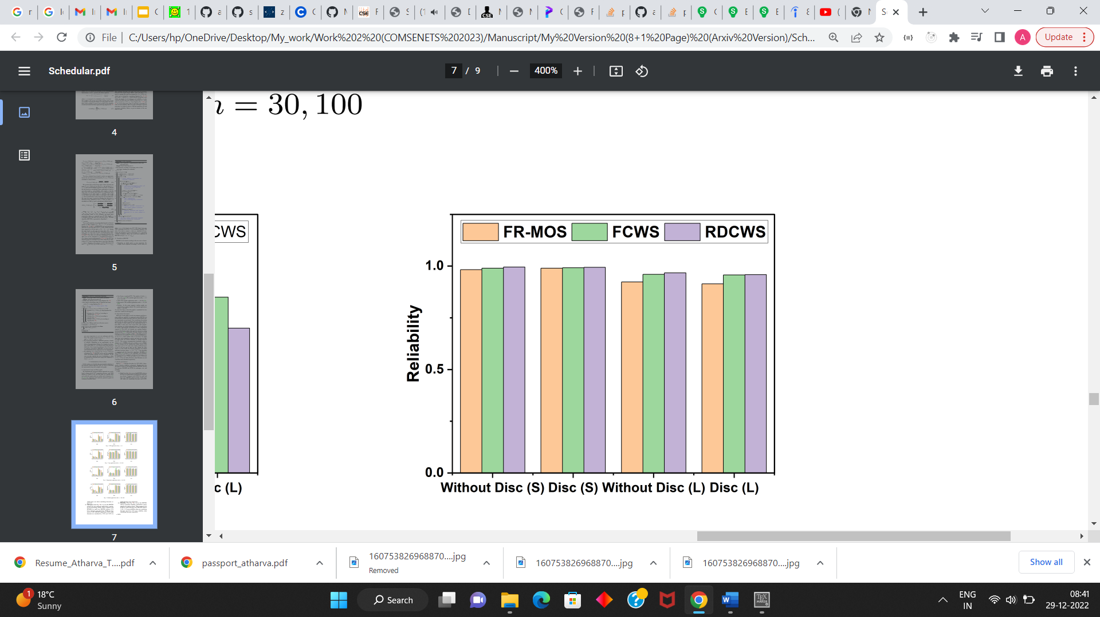
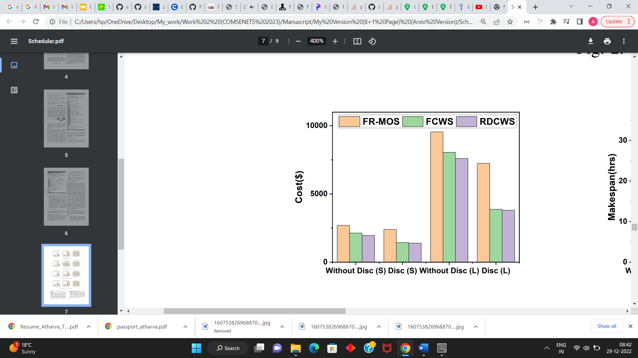
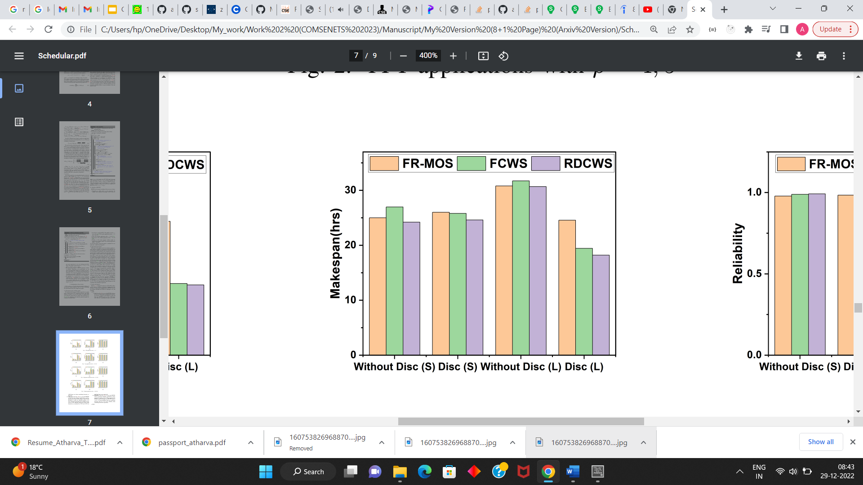
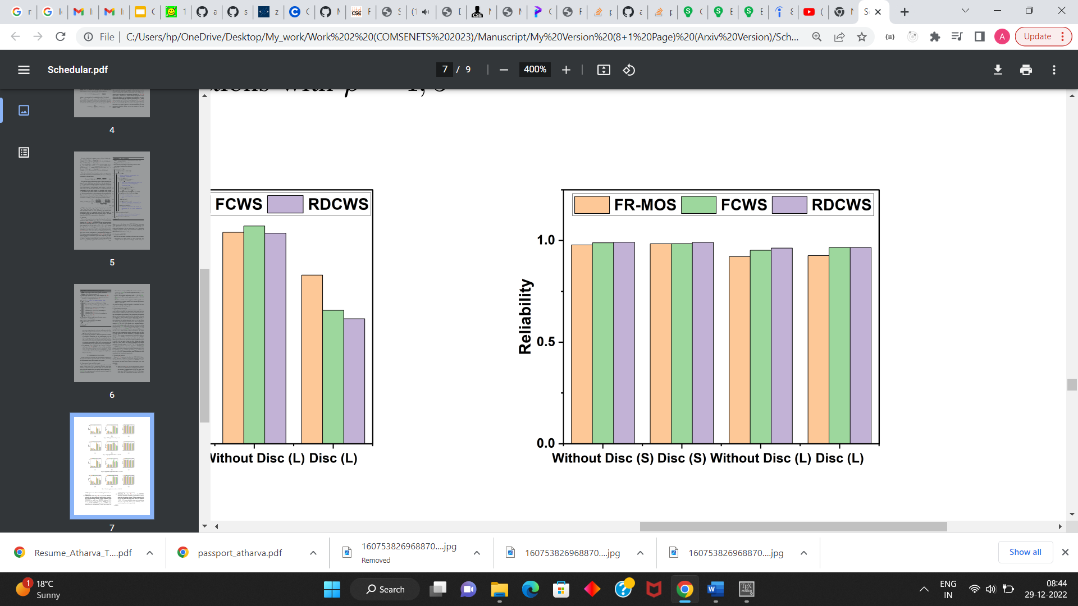
Results
(a) Epigenomics: ‘Cost’
(b) Epigenomics: ‘Makespan’
(c) Epigenomics: ‘Reliability’
(d) LIGO: ‘Cost’
(e) LIGO: ‘Makespan’
(f) LIGO: ‘Reliability’
Figure 1. No. of billboard slots Vs. Influence plots for all location type

Slide 18
Conclusion & Future work
In this paper, we have studied the problem of scheduling a scientific workflow in a multi-cloud system where the goal is to minimize the makespan, cost and to maximize reliability.
We have proposed a complete systems model that integrates communication costs, different billing mechanisms, sustained use discounts and done the task reliability analysis.
To solve this problem we have designed a list scheduling approach that allocates tasks based on rent time.
In the future we will try to include more practical concerns such as security and load balance.

Slide 19
References
T. Mastelic, A. Oleksiak, H. Claussen, I. Brandic, J.-M. Pierson, and A. V. Vasilakos, “Cloud computing: Survey on energy efficiency,” Acm computing surveys (csur), vol. 47, no. 2, pp. 1–36, 2014.
X. Zhou, G. Zhang, J. Sun, J. Zhou, T. Wei, and S. Hu, “Minimizing cost and makespan for workflow scheduling in cloud using fuzzy dominance sort based heft,” Future Generation Computer Systems, vol. 93, pp. 278– 289, 2019.
M. Farid, R. Latip, M. Hussin, and N. A. W. A. Hamid, “Scheduling scientific workflow using multi-objective algorithm with fuzzy resource utilization in multi-cloud environment,” IEEE Access, vol. 8, pp. 24 309– 24 322, 2020
X. Tang, “Reliability-aware cost-efficient scientific workflows scheduling strategy on multi-cloud systems,” IEEE Transactions on Cloud Computing, 2021.
L. Han, L.-C. Canon, H. Casanova, Y. Robert, and F. Vivien, “Checkpointing workflows for fail-stop errors,” IEEE Transactions on Computers, vol. 67, no. 8, pp. 1105–1120, 2018.
Z. Wen, J. Cała, P. Watson, and A. Romanovsky, “Cost effective, reliable and secure workflow deployment over federated clouds,” IEEE Transactions on Services Computing, vol. 10, no. 6, pp. 929–941, 2016.
A. Zhou, S. Wang, B. Cheng, Z. Zheng, F. Yang, R. N. Chang, M. R. Lyu, and R. Buyya, “Cloud service reliability enhancement via virtual machine placement optimization,” IEEE Transactions on Services Computing, vol. 10, no. 6, pp. 902–913, 2016.
X. Li, H. Ma, W. Yao, and X. Gui, “Data-driven and feedback-enhanced trust computing pattern for large-scale multi-cloud collaborative services,” IEEE transactions on services computing, vol. 11, no. 4, pp. 671–684, 2015.
J. Diaz-Montes, M. Diaz-Granados, M. Zou, S. Tao, and M. Parashar, “Supporting data-intensive workflows in software-defined federated multi-clouds,” IEEE Transactions on Cloud Computing, vol. 6, no. 1, pp. 250–263, 2015.
D. Trihinas, G. Pallis, and M. D. Dikaiakos, “Monitoring elastically adaptive multi-cloud services,” IEEE Transactions on Cloud Computing, vol. 6.
S. A. Miraftabzadeh, P. Rad, and M. Jamshidi, “Efficient distributed algorithm for scheduling workload-aware jobs on multi-clouds,” in 2016 11th System of Systems Engineering Conference (SoSE). IEEE, 2016, pp. 1–8.
S. Kang, B. Veeravalli, and K. M. M. Aung, “Dynamic scheduling strategy with efficient node availability prediction for handling divisible loads in multi-cloud systems,” Journal of Parallel and Distributed Computing, vol. 113, pp. 1–16, 2018.
B. A. Al-Maytami, P. Fan, A. Hussain, T. Baker, and P. Liatsis, “A task scheduling algorithm with improved makespan based on prediction of tasks computation time algorithm for cloud computing,” IEEE Access, vol. 7, pp. 160 916–160 926, 2019.

Slide 20
References
N. Sooezi, S. Abrishami, and M. Lotfian, “Scheduling data-driven workflows in multi-cloud environment,” in 2015 IEEE 7th international conference on cloud computing technology and science (CloudCom). IEEE, 2015, pp. 163–167.
R. Li, C. Q. Wu, A. Hou, Y. Wang, T. Gao, and M. Xu, “On scheduling of high-throughput scientific workflows under budget constraints in multi-cloud environments,” in 2018 IEEE Intl Conf on Parallel & Distributed Processing with Applications, Ubiquitous Computing & Communications, Big Data & Cloud Computing, Social Computing & Networking, Sustainable Computing & Communications (ISPA/IUCC/BDCloud/SocialCom/SustainCom). IEEE, 2018, pp. 1087– 1094.
S. Di, Y. Robert, F. Vivien, and F. Cappello, “Toward an optimal online checkpoint solution under a two-level hpc checkpoint model,” IEEE Transactions on parallel and distributed systems, vol. 28, no. 1, pp. 244–259, 2016.
M. L. Stillwell, F. Vivien, and H. Casanova, “Virtual machine resource allocation for service hosting on heterogeneous distributed platforms,” in IPDPS 2012. IEEE, x-pays= US, 2012.
E. Barrett, E. Howley, and J. Duggan, “A learning architecture for scheduling workflow applications in the cloud,” in 2011 IEEE ninth European conference on web services. IEEE, 2011, pp. 83–90.
S. Khatua and N. Mukherjee, “A novel checkpointing scheme for amazon ec2 spot instances,” in 2013 13th IEEE/ACM International Symposium on Cluster, Cloud, and Grid Computing. IEEE, 2013, pp. 180–181.
D. A. Monge, E. Pacini, C. Mateos, E. Alba, and C. G. Garino, “Cmi: An online multi-objective genetic autoscaler for scientific and engineering workflows in cloud infrastructures with unreliable virtual machines,” Journal of Network and Computer Applications, vol. 149, p. 102464, 2020.
Z. Cai, X. Li, and J. N. Gupta, “Heuristics for provisioning services to workflows in xaas clouds,” IEEE Transactions on Services Computing, vol. 9, no. 2, pp. 250–263, 2014.

Slide 21
References
“Resource-based pricing,” https://cloud.google.com/compute/ resource-based-pricing, accessed 21 August 2022.
“Sustained use discounts,” https://cloud.google.com/compute/docs/ sustained-use-discounts, accessed 21 August 2022.
G. Xie, Y. Chen, X. Xiao, C. Xu, R. Li, and K. Li, “Energy-efficient fault-tolerant scheduling of reliable parallel applications on heterogeneous distributed embedded systems,” IEEE Transactions on Sustainable Computing, vol. 3, no. 3, pp. 167–181, 2017.
H. Topcuoglu, S. Hariri, and M.-Y. Wu, “Performance-effective and low-complexity task scheduling for heterogeneous computing,” IEEE transactions on parallel and distributed systems, vol. 13, no. 3, pp. 260– 274, 2002.
C. Szabo and T. Kroeger, “Evolving multi-objective strategies for task allocation of scientific workflows on public clouds,” in 2012 IEEE Congress on Evolutionary Computation. IEEE, 2012, pp. 1–8.
H. Hu, Z. Li, H. Hu, J. Chen, J. Ge, C. Li, and V. Chang, “Multiobjective scheduling for scientific workflow in multicloud environment,” Journal of Network and Computer Applications, vol. 114, pp. 108–122, 2018.

Slide 22
Thank You!!!

